Slide 1

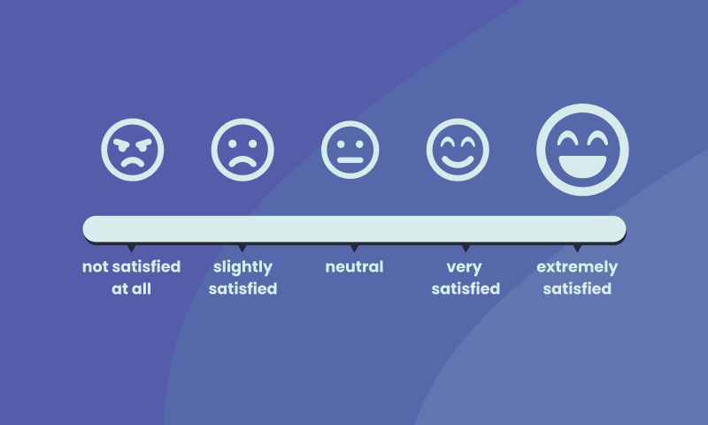
Likert scale
Submitted by:
Mrinal Joshi (221028)
Rajshree M (221037)
Vedashree (221033)
Laheri (221024)
Seema (221044)
Rajlakshmi(221058)
Vineela(221027)
Sowjanya(221048)
Neelansh (221030)

Slide 2
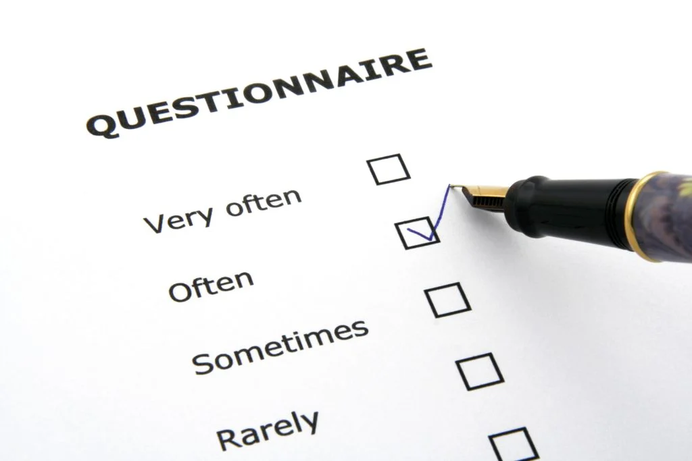
Likert scale
A Likert scale is a rating scale used to measure attitudes, opinions, beliefs, or perceptions of an individual or a group of individuals. It consists of a set of statements or items that the respondent is asked to evaluate on a 5-point or 7-point scale ranging from "strongly agree" to "strongly disagree" or "very satisfied" to "very dissatisfied".
The Likert scale was developed by Rensis Likert in the 1930s and is widely used in social science research, market research, and opinion polls. The responses are usually scored and the mean or median score is calculated to provide a summary of the respondents' attitudes towards the topic being studied. The Likert scale is a useful tool for measuring attitudes because it allows for quantitative analysis of qualitative data.

Slide 3
Questionnaire
1) How Satisfied are you with the level of customer service provided by your bank
Very Satisfied | Satisfied | Neutral | Dissatisfied | Very dissatisfied
Very Likely | Likely | Neutral | Unlikely | Very Unlikely
Strongly Agree | Agree | Neutral | Disagree | Strongly Disagree
Very Satisfied | Satisfied | Neutral | Dissatisfied | Very dissatisfied
2) How likely are you to recommend your bank to a friend or a gamily member?
3) To what extent do you agree that your bank offers competitive interest rates on its products
4) How satisfied are you with the overall banking experience at SBI?

Slide 4
Questionnaire
5) How satisfied are you with the online banking services provided by your bank?
Very Satisfied | Satisfied | Neutral | Dissatisfied | Very dissatisfied
Very Satisfied | Satisfied | Neutral | Dissatisfied | Very dissatisfied
Strongly Agree | Agree | Neutral | Disagree | Strongly Disagree
Strongly Agree | Agree | Neutral | Disagree | Strongly Disagree
6) How satisfied are you with the speed and efficiency of transactions at your bank?
7) To what extent do you agree that your bank values and respects its customer
8) To what extent do you agree that your bank provides clear and transparent information at your bank?

Slide 5
Very Satisfied | Satisfied | Neutral | Dissatisfied | Very dissatisfied
Q) Are you satisfied with our PPT
THANK YOU

